Slide 1
a model and method for a circular CO2 economy
20210824WA regarding the CO2 chain deep learning model

Slide 2
CO2 chain deep learning model

Slide 3
202108 Current Version
Process
object classification
Digital Image
a
Classification
b
c
Detailed Classifications
Detailed Recognition
autoencoder model
3d components
mass and materials
object definitions
d
database
Object IDs to database
e
supply chain prediction
Object IDs to symbols
f
Symbol Sequence Prediction
g

Slide 4
object detector models

Slide 5
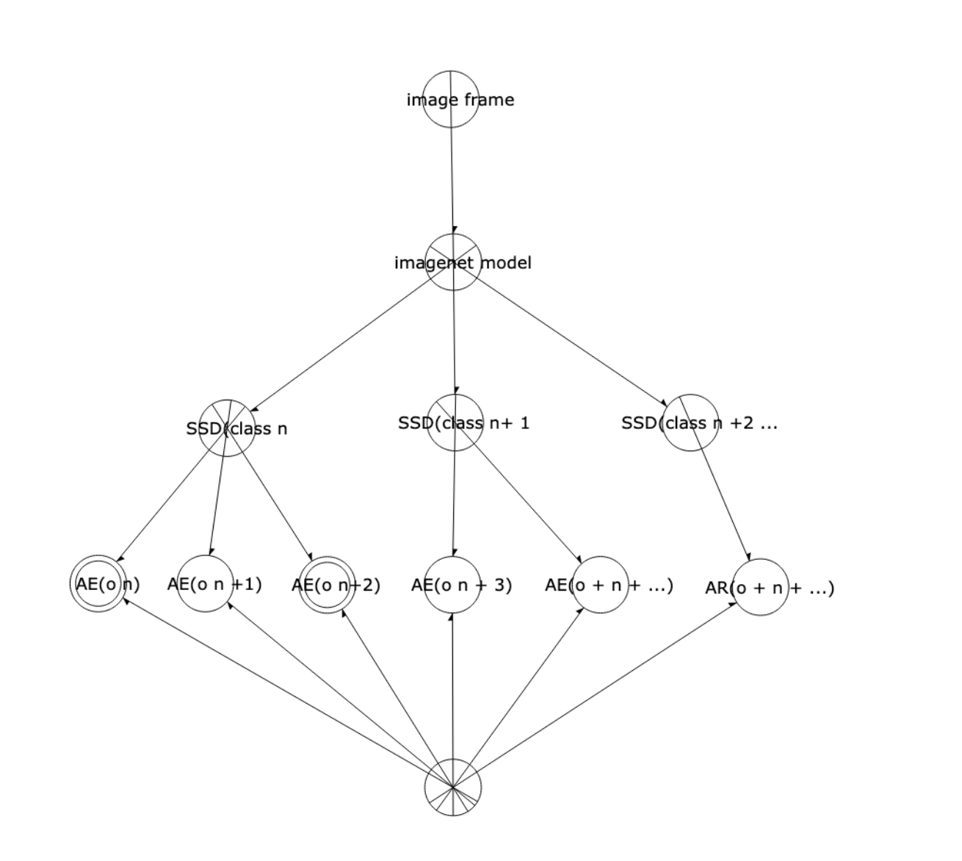
202108 Current Version

Slide 6
202108 Current Version
Sensor
[] [] Frames [] []
Image 1
Image 2
Image 3
Image 4
a
animal
vehicle
bottle
bottle
b
SSD
Class cow
SSD
Class truck
SSD
Class yakult0
SSD
Class yakult1
c
Cow
Truck
Yakult Bottle
Empty Yakult Bottle
d
autoencoder
detector
model
autoencoder
detector
model
autoencoder
detector
model
autoencoder
detector
model
-600
-80
-881.123
+120
e
[s1]
[s2]
[s3]
[s4]
f
(-370)+(-230)
+
(-20)+(-40)+(-20)
+
+
g
(-80)+(-800)+(-1.123)
120

Slide 7
The CO2 chain deep learning model
details

Slide 8
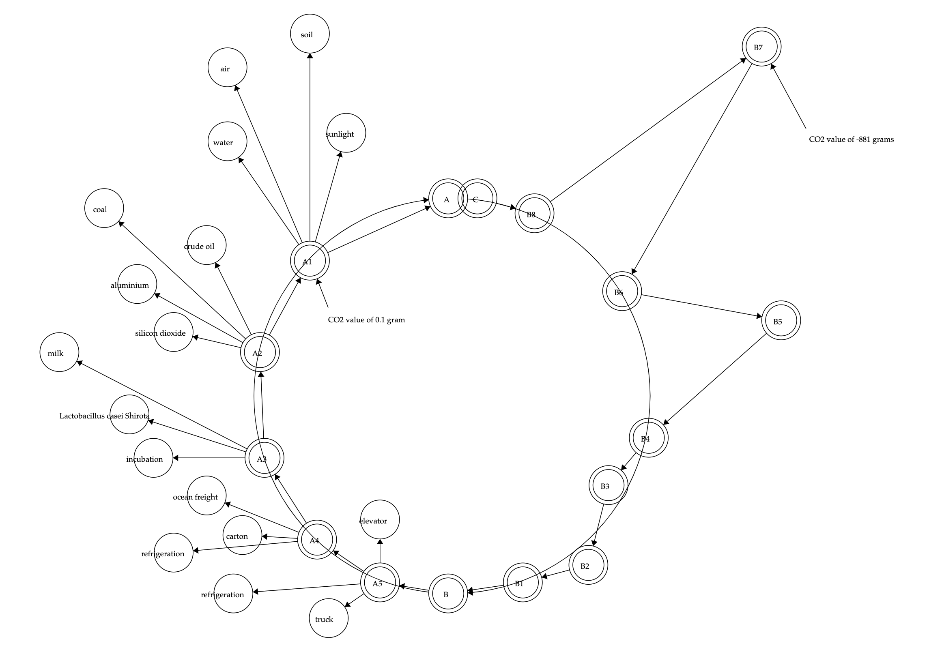
202108 Current Version
Input Image Data about an Object
object classification
Digital Image
a
Classification
b
c
Detailed Classifications
Detailed Recognition
autoencoder model
3d components
mass and materials
object definitions
process steps
d
database
Object IDs to database
e
supply chain prediction
Object IDs to symbols
f
Symbol Sequence Prediction
g
output: a Circularity Accounting Model
of the object

Slide 9
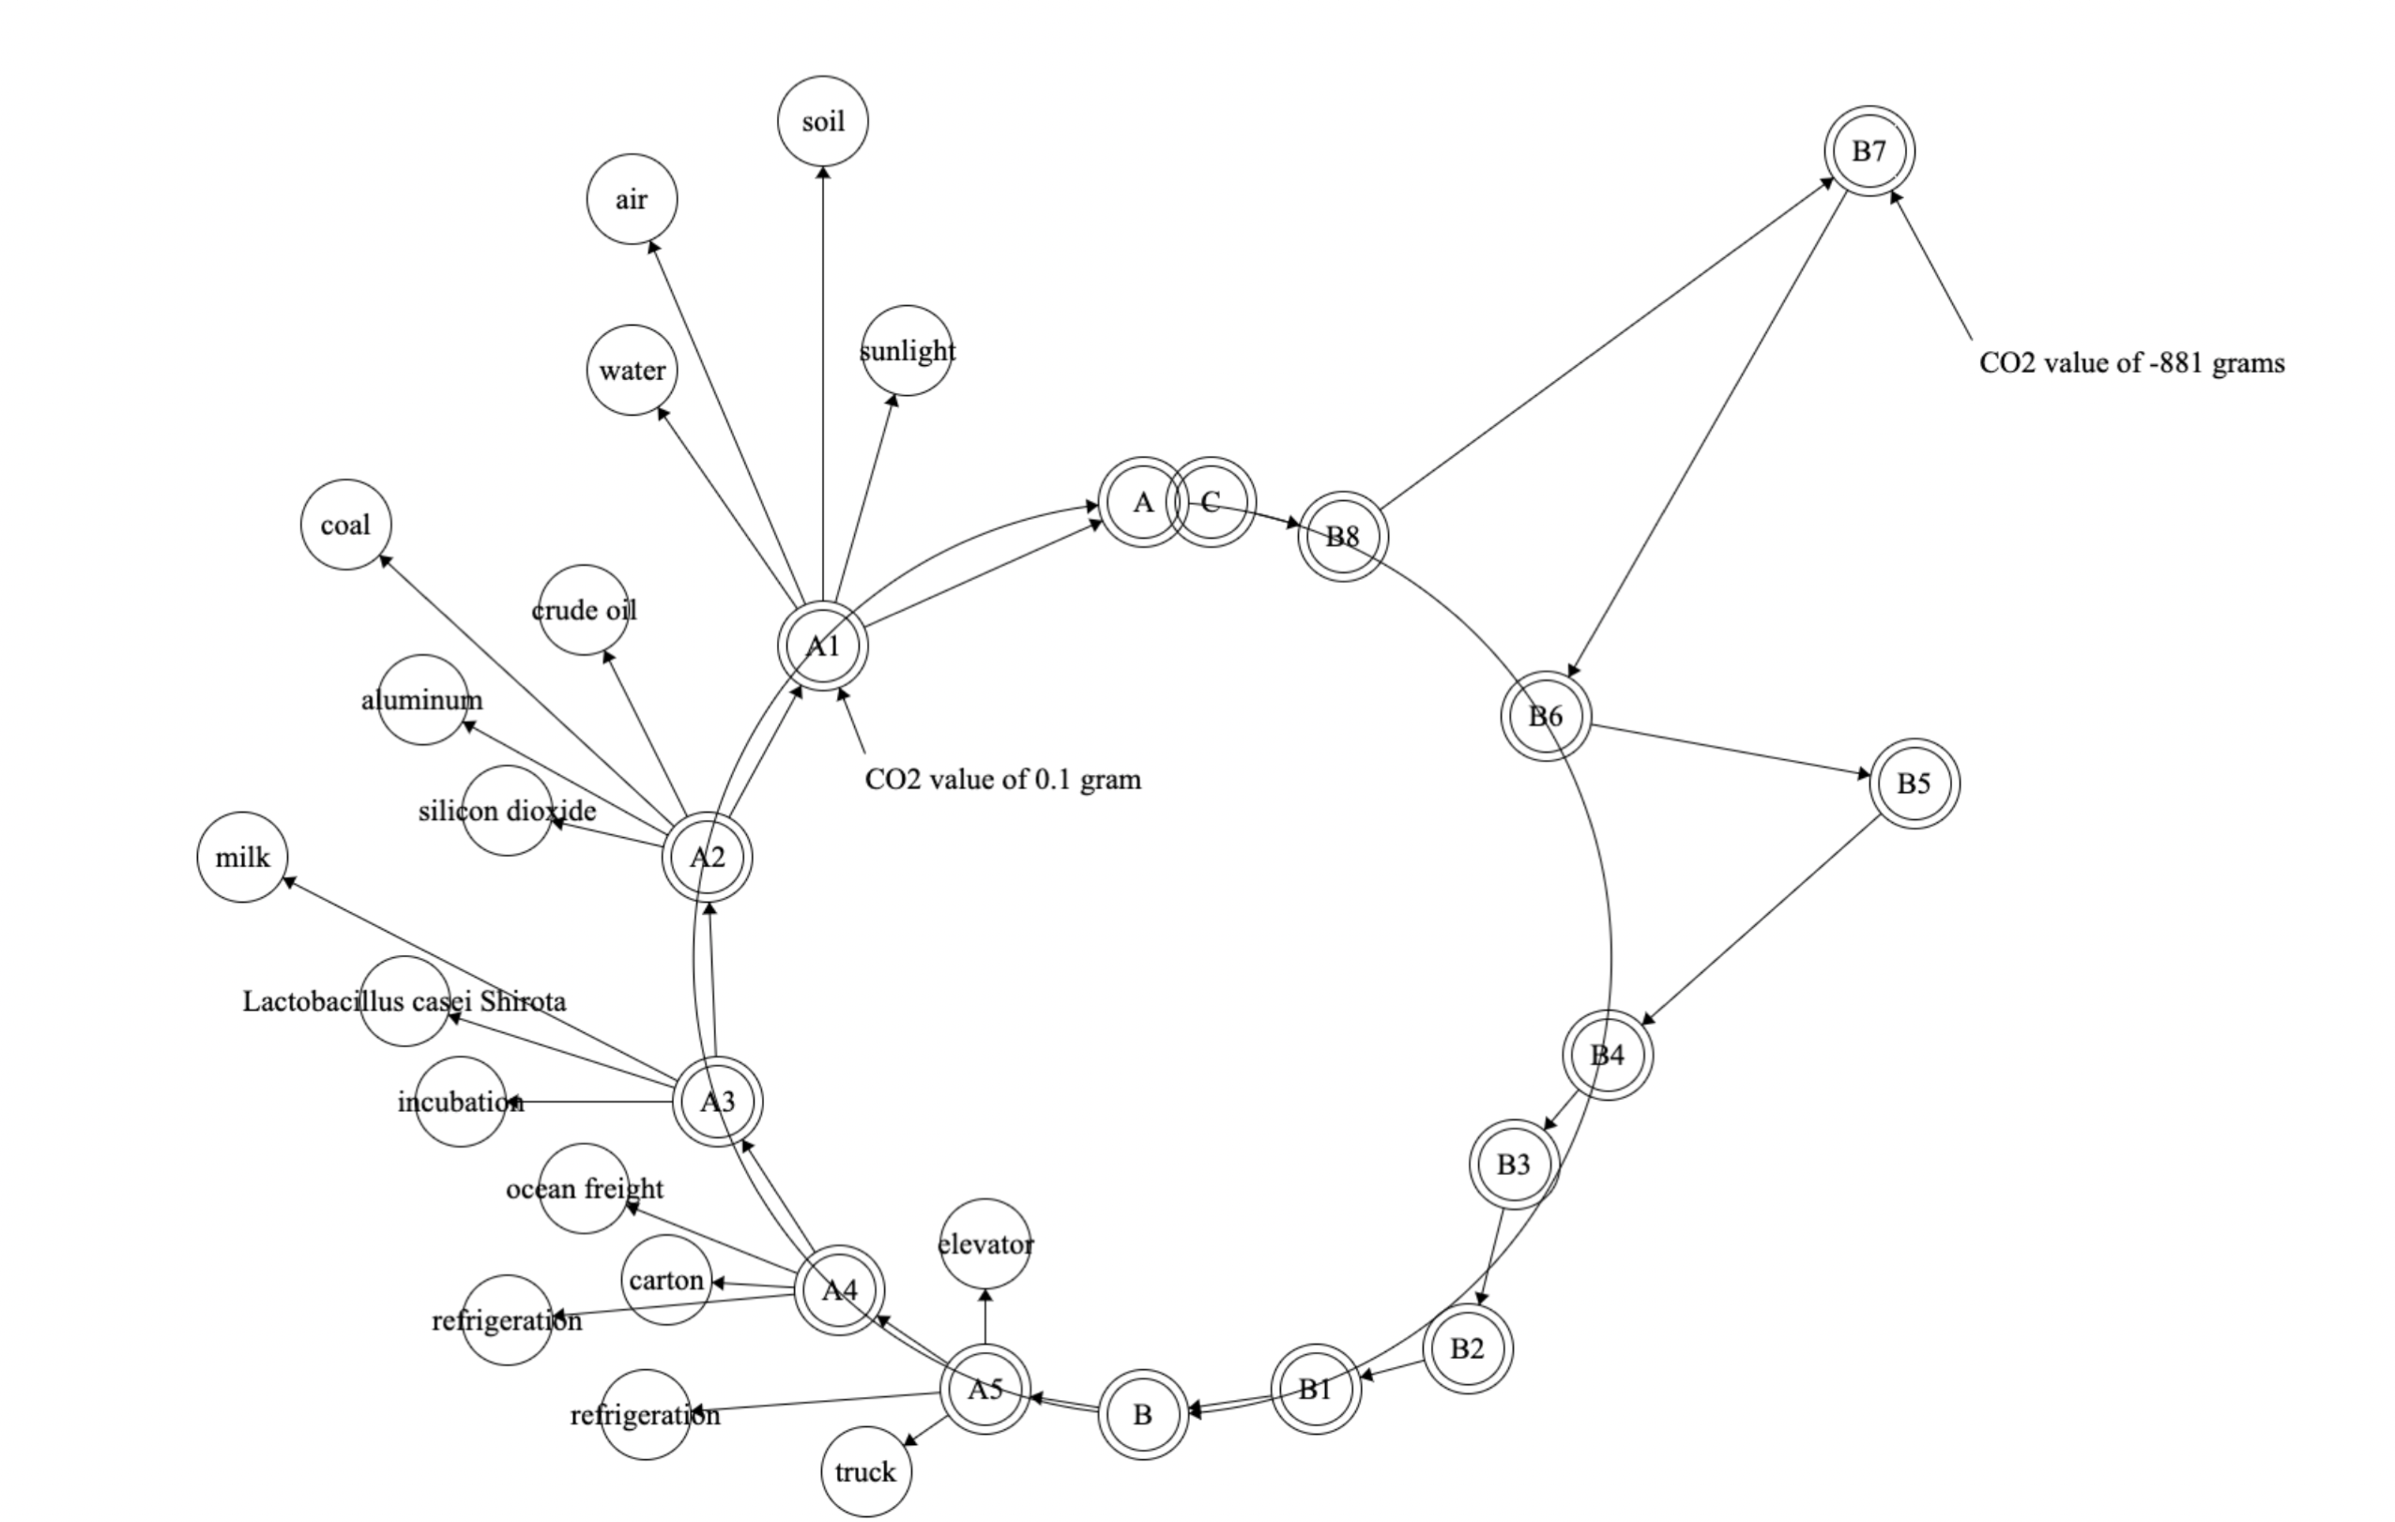
The simplified version of the graph is what we are using as the ‘circularity economy’ diagram, which shows the carbon values as distances from a circle.
At each position there is a different CO2 value.

Slide 10
requires data that describes the supply chain and the disposal chain
how to conceptualize and encode the steps in a supply-destruction chain model

Slide 11
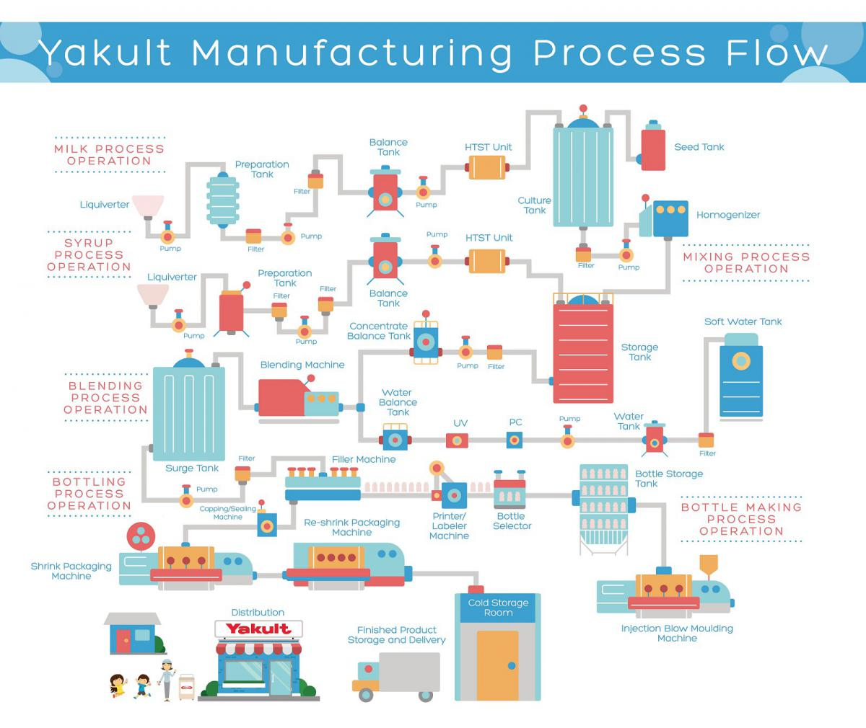
how to conceptualize and encode the steps in a supply-destruction chain model

Slide 12
consumption vectors

Slide 13
consumption vectors
water1 softWaterTank1 waterTank1 waterBalanceTank1 blendingMachine1 surgeTank1 filterMachine1 cappingSealingMachine1 shrinkPackagingMachine1 reshrinkPackagingMachine1 coldStorage1 yakult1
sugarcane1 sugar1 syrup1 liquiverter1 preparationTank1 balanceTank1 htstUnit1 storageTank1 concentrateBalanceTank1 blendingMachine1 surgeTank1 filterMachine1 cappingSealingMachine1 shrinkPackagingMachine1 reshrinkPackagingMachine1 coldStorage1 yakult1
lactobacillus seedTank1 cultureTank1 homogenizer1 storageTank1 concentrateBalanceTank1 blendingMachine1 surgeTank1 filterMachine1 cappingSealingMachine1 shrinkPackagingMachine1 reshrinkPackagingMachine1 coldStorage1 yakult1
cow1 nonfatMilk1 liquiverter2 preperationTank2 balanceTank2 htstUnit2 cultureTank1 homogenizer1 storageTank1 concentrateBalanceTank1 blendingMachine1 surgeTank1 filterMachine1 cappingSealingMachine1 shrinkPackagingMachine1 reshrinkPackagingMachine1 coldStorage1 yakult1
naturalflavors homogenizer1 storageTank1 concentrateBalanceTank1 blendingMachine1 surgeTank1 filterMachine1 cappingSealingMachine1 shrinkPackagingMachine1 reshrinkPackagingMachine1 coldStorage1 yakult1
petroleum1 polystyreneResin1 injectionBlowMouldingMachine1 bottleStorageTank1 bottleSelector1 printerLabelerMachine1 filterMachine1 cappingSealingMachine1 shrinkPackagingMachine1 reshrinkPackagingMachine1 coldStorage1 yakult1
soybean1 soybeanOil1 ink1 printerLabelerMachine1 filterMachine1 cappingSealingMachine1 shrinkPackagingMachine1 reshrinkPackagingMachine1 coldStorage1 yakult1

Slide 14
water1 softWaterTank1 waterTank1 waterBalanceTank1 blendingMachine1 surgeTank1 filterMachine1 cappingSealingMachine1 shrinkPackagingMachine1 reshrinkPackagingMachine1 coldStorage1 yakult1
sugarcane1 sugar1 syrup1 liquiverter1 preparationTank1 balanceTank1 htstUnit1 storageTank1 concentrateBalanceTank1 blendingMachine1 surgeTank1 filterMachine1 cappingSealingMachine1 shrinkPackagingMachine1 reshrinkPackagingMachine1 coldStorage1 yakult1
lactobacillus seedTank1 cultureTank1 homogenizer1 storageTank1 concentrateBalanceTank1 blendingMachine1 surgeTank1 filterMachine1 cappingSealingMachine1 shrinkPackagingMachine1 reshrinkPackagingMachine1 coldStorage1 yakult1
cow1 nonfatMilk1 liquiverter2 preperationTank2 balanceTank2 htstUnit2 cultureTank1 homogenizer1 storageTank1 concentrateBalanceTank1 blendingMachine1 surgeTank1 filterMachine1 cappingSealingMachine1 shrinkPackagingMachine1 reshrinkPackagingMachine1 coldStorage1 yakult1
naturalflavors homogenizer1 storageTank1 concentrateBalanceTank1 blendingMachine1 surgeTank1 filterMachine1 cappingSealingMachine1 shrinkPackagingMachine1 reshrinkPackagingMachine1 coldStorage1 yakult1
petroleum1 polystyreneResin1 injectionBlowMouldingMachine1 bottleStorageTank1 bottleSelector1 printerLabelerMachine1 filterMachine1 cappingSealingMachine1 shrinkPackagingMachine1 reshrinkPackagingMachine1 coldStorage1 yakult1
soybean1 soybeanOil1 ink1 printerLabelerMachine1 filterMachine1 cappingSealingMachine1 shrinkPackagingMachine1 reshrinkPackagingMachine1 coldStorage1 yakult1

Slide 15
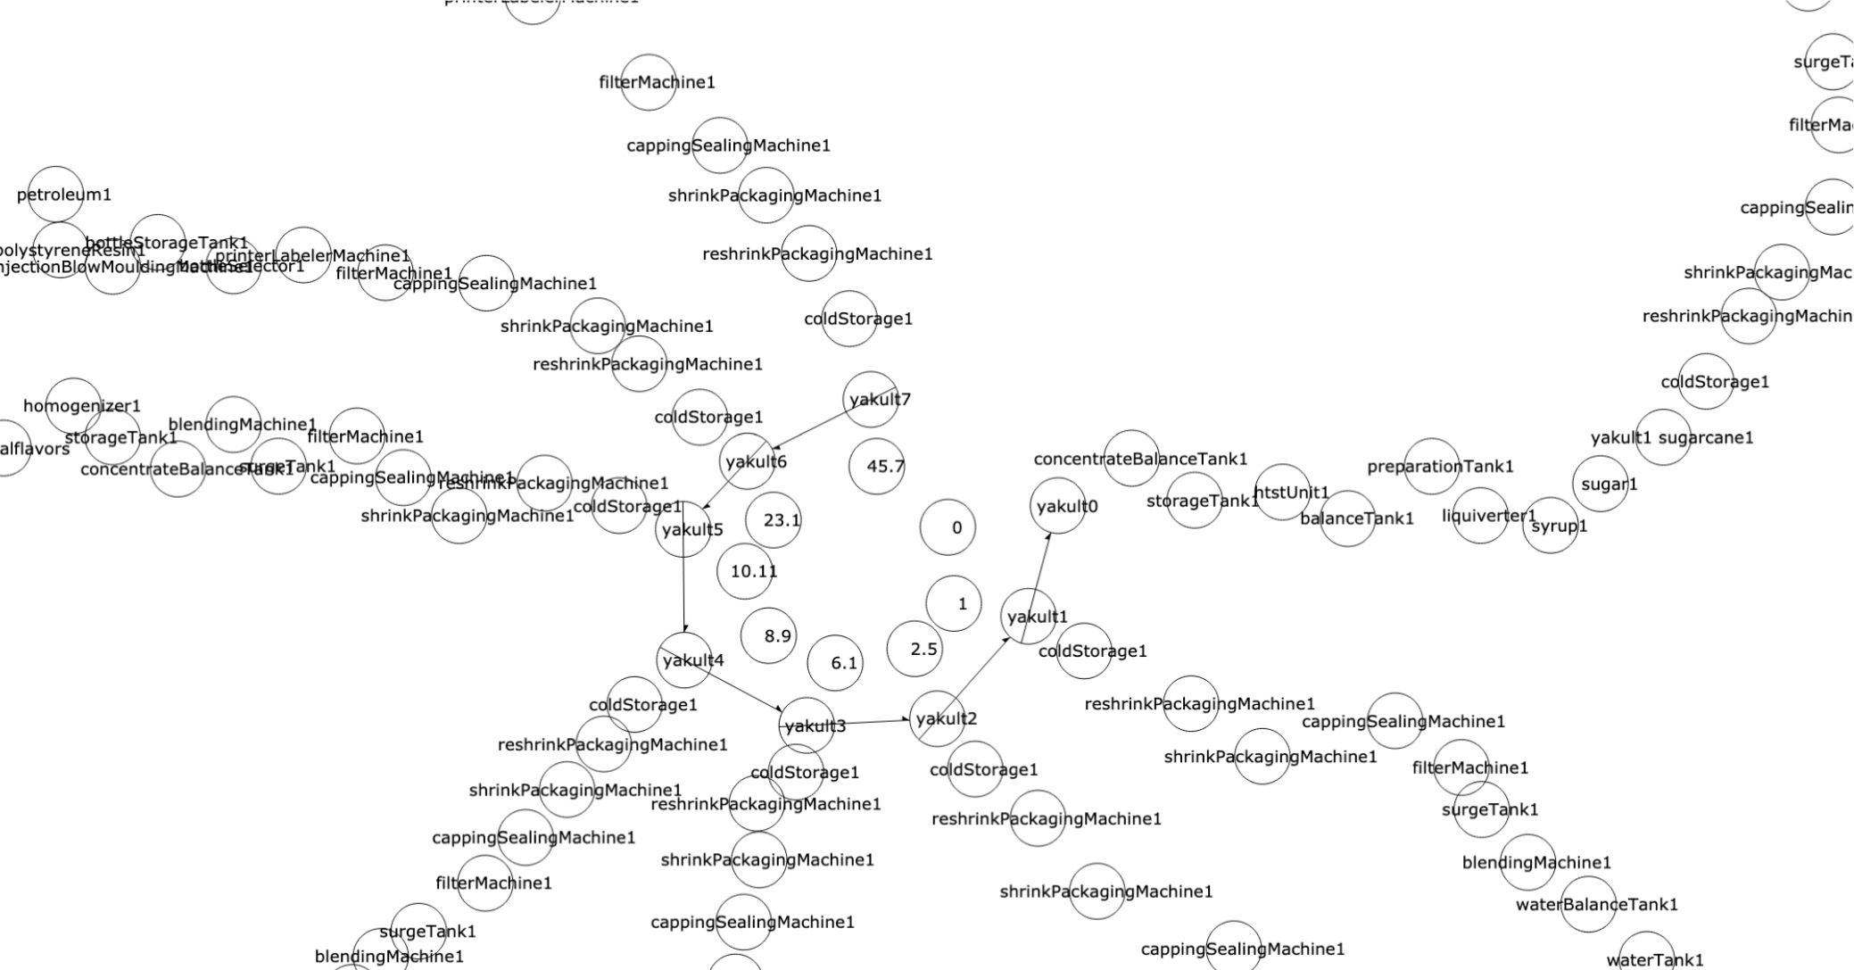
water1 softWaterTank1 waterTank1 waterBalanceTank1 blendingMachine1 surgeTank1 filterMachine1 cappingSealingMachine1 shrinkPackagingMachine1 reshrinkPackagingMachine1 coldStorage1 yakult1
sugarcane1 sugar1 syrup1 liquiverter1 preparationTank1 balanceTank1 htstUnit1 storageTank1 concentrateBalanceTank1 blendingMachine1 surgeTank1 filterMachine1 cappingSealingMachine1 shrinkPackagingMachine1 reshrinkPackagingMachine1 coldStorage1 yakult1
lactobacillus seedTank1 cultureTank1 homogenizer1 storageTank1 concentrateBalanceTank1 blendingMachine1 surgeTank1 filterMachine1 cappingSealingMachine1 shrinkPackagingMachine1 reshrinkPackagingMachine1 coldStorage1 yakult1
cow1 nonfatMilk1 liquiverter2 preperationTank2 balanceTank2 htstUnit2 cultureTank1 homogenizer1 storageTank1 concentrateBalanceTank1 blendingMachine1 surgeTank1 filterMachine1 cappingSealingMachine1 shrinkPackagingMachine1 reshrinkPackagingMachine1 coldStorage1 yakult1
naturalflavors homogenizer1 storageTank1 concentrateBalanceTank1 blendingMachine1 surgeTank1 filterMachine1 cappingSealingMachine1 shrinkPackagingMachine1 reshrinkPackagingMachine1 coldStorage1 yakult1
petroleum1 polystyreneResin1 injectionBlowMouldingMachine1 bottleStorageTank1 bottleSelector1 printerLabelerMachine1 filterMachine1 cappingSealingMachine1 shrinkPackagingMachine1 reshrinkPackagingMachine1 coldStorage1 yakult1
soybean1 soybeanOil1 ink1 printerLabelerMachine1 filterMachine1 cappingSealingMachine1 shrinkPackagingMachine1 reshrinkPackagingMachine1 coldStorage1 yakult1
From the consumption vectors, we can make this graph,
which shows the inputs of carbon on the production ‘circle’ of Yakult.
The circle is the the beginning to the end of the Yakult product.

Slide 16
CO2 values of blue-jeans
…
First, we have bluejeans1; bluejeans2; bluejeans3 etc. which are all positions of bluejeans on the production chain, and at each position there is a different carbon value.

Slide 17
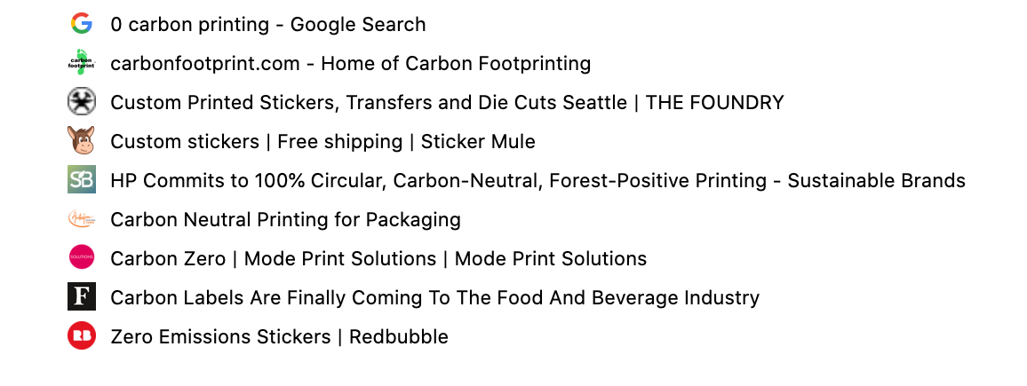
CO2 values of printed paper
what data is available?

Slide 18
CO2 values of PCB boards

Slide 19
water1 softWaterTank1 waterTank1 waterBalanceTank1 blendingMachine1 surgeTank1 filterMachine1 cappingSealingMachine1 shrinkPackagingMachine1 reshrinkPackagingMachine1 coldStorage1 yakult1
sugarcane1 sugar1 syrup1 liquiverter1 preparationTank1 balanceTank1 htstUnit1 storageTank1 concentrateBalanceTank1 blendingMachine1 surgeTank1 filterMachine1 cappingSealingMachine1 shrinkPackagingMachine1 reshrinkPackagingMachine1 coldStorage1 yakult1
lactobacillus seedTank1 cultureTank1 homogenizer1 storageTank1 concentrateBalanceTank1 blendingMachine1 surgeTank1 filterMachine1 cappingSealingMachine1 shrinkPackagingMachine1 reshrinkPackagingMachine1 coldStorage1 yakult1
cow1 nonfatMilk1 liquiverter2 preperationTank2 balanceTank2 htstUnit2 cultureTank1 homogenizer1 storageTank1 concentrateBalanceTank1 blendingMachine1 surgeTank1 filterMachine1 cappingSealingMachine1 shrinkPackagingMachine1 reshrinkPackagingMachine1 coldStorage1 yakult1
naturalflavors homogenizer1 storageTank1 concentrateBalanceTank1 blendingMachine1 surgeTank1 filterMachine1 cappingSealingMachine1 shrinkPackagingMachine1 reshrinkPackagingMachine1 coldStorage1 yakult1
petroleum1 polystyreneResin1 injectionBlowMouldingMachine1 bottleStorageTank1 bottleSelector1 printerLabelerMachine1 filterMachine1 cappingSealingMachine1 shrinkPackagingMachine1 reshrinkPackagingMachine1 coldStorage1 yakult1
soybean1 soybeanOil1 ink1 printerLabelerMachine1 filterMachine1 cappingSealingMachine1 shrinkPackagingMachine1 reshrinkPackagingMachine1 coldStorage1 yakult1

Slide 20
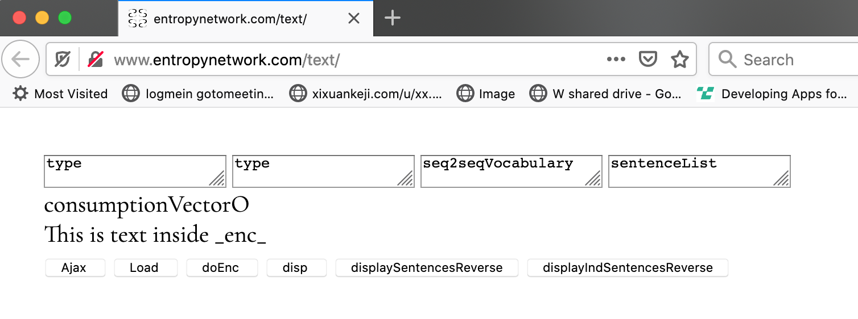
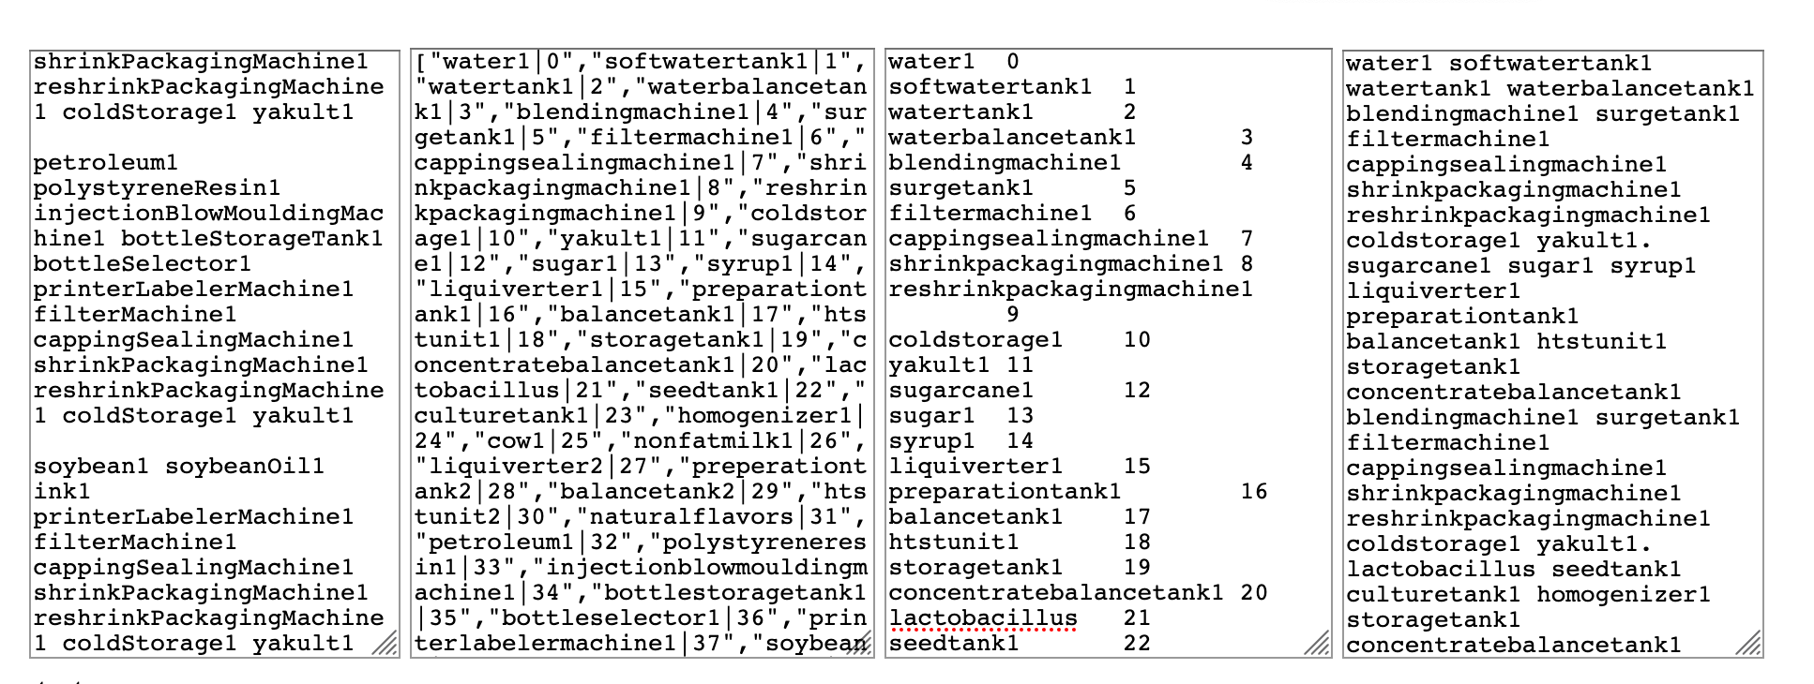
water1 softWaterTank1 waterTank1 waterBalanceTank1 blendingMachine1 surgeTank1 filterMachine1 cappingSealingMachine1 shrinkPackagingMachine1 reshrinkPackagingMachine1 coldStorage1 yakult1
http://www.entropynetwork.com/text/

Slide 21
CO2 values
water1 | 0
softwatertank1 | ?
watertank1 | ?
waterbalancetank1 | ?
blendingmachine1 | ?
surgetank1 | ?
filtermachine1 | ?
cappingsealingmachine1 | ?
shrinkpackagingmachine1 | ?
reshrinkpackagingmachine1 | ?
coldstorage1 | ?
yakult1 | ?
sugarcane1 | ?
sugar1 | ?
syrup1 | ?
liquiverter1 | ?
preparationtank1 | ?
balancetank1 | ?
htstunit1 | ?
storagetank1 | ?
concentratebalancetank1 | 20
lactobacillus | 21
seedtank1 | 22
culturetank1 | 23
homogenizer1 | 24
cow1 | 25
nonfatmilk1 | 26
liquiverter2 | 27
preperationtank2 | 28
balancetank2 | 29
htstunit2 | 30
naturalflavors | 31
petroleum1 | 32
polystyreneresin1 | 33
injectionblowmouldingmachine1 | 34
bottlestoragetank1 | 35
bottleselector1 | 36
printerlabelermachine1 | 37
soybean1 | 38
soybeanoil1 | 39
ink1 | 40

