Slide 1

Comments and Feedback to Circularity Accounting

Slide 2
Theoretical framework
AF SI
-(ed) Lack of a sufficiently strong connection between CAM and movement building
-(R1) Struggling with the suggestion that change in society is through individual, consumer-based action. While one might advance that corporations are the central issue and asking consumers to be the sole solution is not fair, there are also calls for this very thing. Fairness notwithstanding, spending some time and energy discussing the individual action as a form of accumulated agency might be a path forward (e.g., Latour 2017 – Facing Gaia – Eight lectures on the new climate regime; Rodrique and Romi 2021 – online Critical Perspectives on Accounting).

Slide 3
Theoretical framework
AF SI
-(R2) My main concerns cover your use/interpretation of movement building and its relationship to the CAM. There appears to be no intrinsic link between CAM and movement building; in part that is recognised in the two separate contributions. If this interpretation is incorrect I advise making clear the necessary interdependency of each.
Before I review the authors' interpretation of movement building, there is a more fundamental issue that needs addressing. It is very welcome to see the authors attempting an exploration of how societal change may come about (with CAM as one part of that), rather than just asserting that greater, more appropriate and accurate disclosure is a good thing in, and of, itself. The problem is that the authors appear to subscribe to the view that the way we change society is through individual, consumer-based actions (e.g. on p. 15, "In this sense, it aims to empower consumers and other stakeholders to be part of the information process and not only passive users", or on p. 17, "…
the estimator is an open tool that empowers consumers with the capability of not only being passive receivers of information but also to become providers of information for better decision-making").

Slide 4
Theoretical framework
AF SI
-(R2) Such a view of societal change seems at odds with their invocation of movement building which as Cabaj & Weaver (2016) locate is a version of "Collective Impact 3.0: An Evolving Framework for Community Change". So the emphasis is on collective actions by communities. This inconsistency needs to be addressed and either amended or explained, so that the reader is clear about how the authors envisage social change occurring.
There is also the related issue about placing the emphasis on consumers to change behaviour, thereby bypassing the behaviour of corporations, especially when there is evidence of the impact corporations are having on global emissions - for example, see the CDP "Carbon Majors Report" (2017) or "Carbon Majors: Accounting for carbon and methane emissions 1854-¬2010 Methods & Results Report" by Richard Heede (2019) or Ekwurzel, B., Boneham, J., Dalton, M.W. et al. The rise in global atmospheric CO2, surface temperature, and sea level from emissions traced to major carbon producers. Climatic Change 144, 579-590 (2017). https://doi.org/10.1007/s10584-017-1978-0
The point is, if the producers are the problem then getting the consumers to change won't stop climate change emissions.

Slide 5
Theoretical framework
AF SI
-(R2) Section 2.2.→With this clarification in mind, section 2.2 currently reads in an extremely abstract manner, shorn of almost any social context. There is no build-up to the exposition of movement building (for example an explanation of its theoretical roots or previous uses). There also seems to be some conflation of ideas about movement building – for example Spicer et al. (2016) and Cabaj & Weaver (2016) are two key references in the section but they are coming from different places. Spcier et al. (2016) reference the extant social movements literature (you could criticise them for not engaging further with that literature). Whereas for Cabaj & Weaver (2016) it is not the social movement literature but an extension of the social innovation literature.

Slide 6
Theoretical framework
AF SI
-(R2) Section 2.2.→Cont- It may be possible to overcome this gap but it requires a careful exposition of the roots and links between the different sources of literature in section 2.2. At the moment the impression is left that just because they both use
the term "movement building" they are talking about the same thing.

Slide 7
Figures
AF SI
-(ed) Figure 2 is ambiguous and difficult to understand
-(R1) This paper uses Figure 2 to describe the Model Architecture. It is difficult to understand the innovativeness of those strategies. Some detailed explanations including the purpose of proposing the Model Architecture in addition to its advantages compared with existing architectures, and its detailed steps, should be provided.

Slide 8
Figures
AF SI
-(R2) Figure 2, sections 4.2 and 4.3, appear crucial to understanding the CAM and while there is some explanation in the text (pp. 12-13) it is too brief. The Yakult example in section 4.3 requires more detailed explanation. A clear working through of the numbers in Figure 2 to explain where they have all come from and how the value of - 881.123 is derived, would help. Also a clear statement of whether these are real or theoretical values is needed.

Slide 9
Model- CAM
AF SI
-(ed) Elaboration on CAM as circular
-(R2) A nagging question throughout the paper was whether the CAM is actually circular. I know you represent it as such in Figure 3 with points A and C touching/overlapping. Yet, the paper often refers to the supply-disposal chains, such
chains could of course be linear, as they are mainly in present economic activity. You appear to try to address this concern in footnote 1 (p. 3) but it is rather cryptic - a clearer elaboration in the body of the paper is advised.

Slide 10
Operationalizacion of CAM
AF SI
-(R1) Although the approach proposed in the paper is interesting, a revision of the manuscript is recommended. In particular, to improve section 5 (CAM for the operationalization of CE) and the overall style of the paper

Slide 11
Contributions
AF SI
-(R1) Statements about the contributions of the paper are not clear enough. The author should list the contributions of the paper in detail in the Introduction
-

Slide 12
Conclusions
AF SI
-(R1) The conclusions are repetitive and insubstantial. Conclusions must be focused on the contribution and results of the work. Future research work must be sufficiently widely argued. Please open a real window for future work in the conclusion section. The authors need to clearly provide 2-3 solid future research directions in the Conclusion section

Slide 13
Others
AF SI
-(R1) There are grammatical errors that need to be corrected.-

Slide 14
Others
AF SI
-(R2) Other points
1. P. 2 - "real flow" could do with some clarification;
2. P. 6 - "In order to advance in the development of circular economy …" the "in" is not needed;
3. P. 6 - the final sentence needs re-writing;
4. P. 7 - third line "being needed" is not needed;
5. P. 8 and Section 3 - you refer on p. 8 to the challenges that machine and non-human agency can/will create,
yet this is not explained until later in section 3. So consider moving section earlier;
6. Section 3 - you appear to be arguing that it is machine and non-human agency that is the cause of increasing
carbon emissions. If this is your position, then you need a much more careful and detailed exposition. For example, in figure 1, is this a theoretical model or based on actual data? The timescales on the Y-axis seem inappropriate, is this really a matter of months? More fundamentally the common understanding is that we are reaching the planet’s resource limits because of capitalism's inbuilt need for 3% compound annual growth, not the use of machines;
7. P. 10 - bottom before the Roman numerals you need to include commas or semi-colons, not full stops;
8. P.10, Fn. 2 - should that read "… through software…"? Similar issue at the start of section 4.1

Slide 15
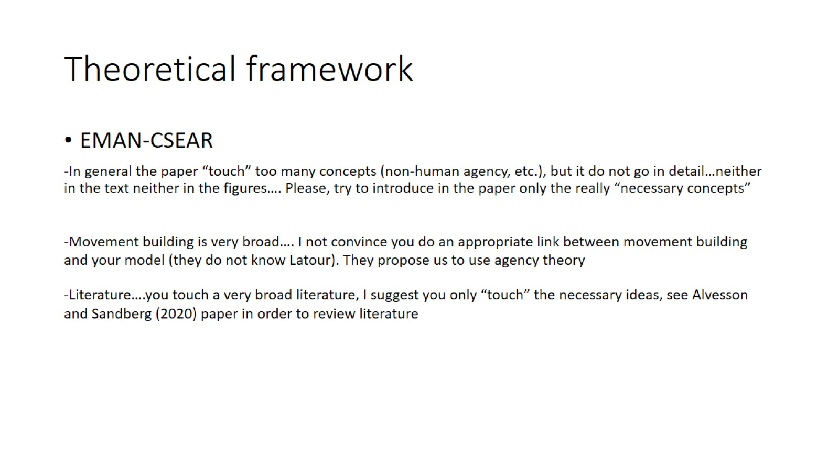
Theoretical framework

Slide 16
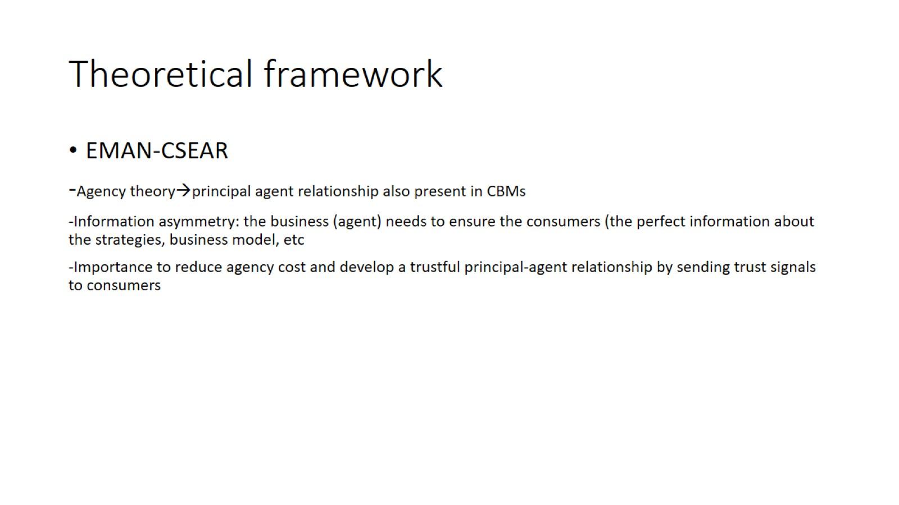
Theoretical framework

Slide 17
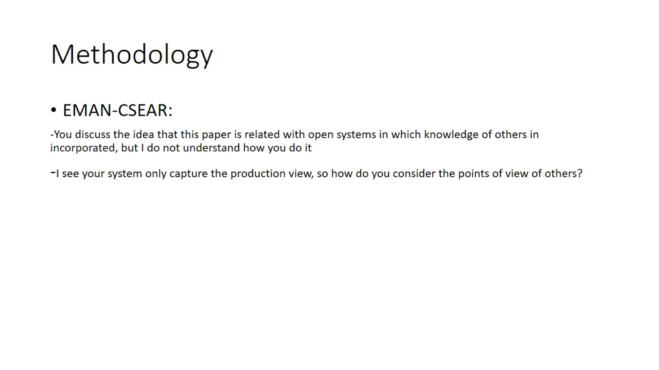
Methodology

Slide 18
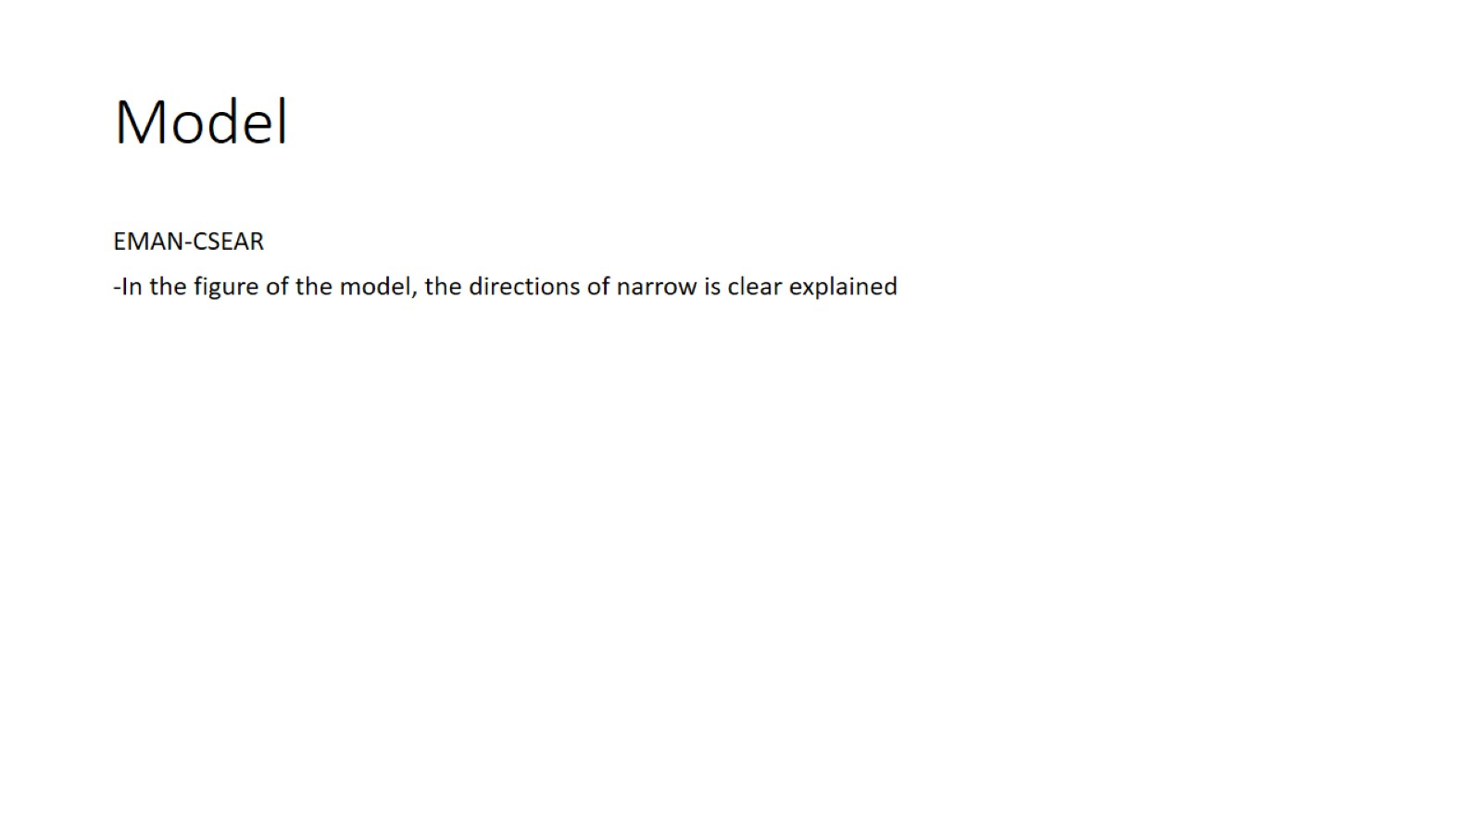
Model

Slide 19
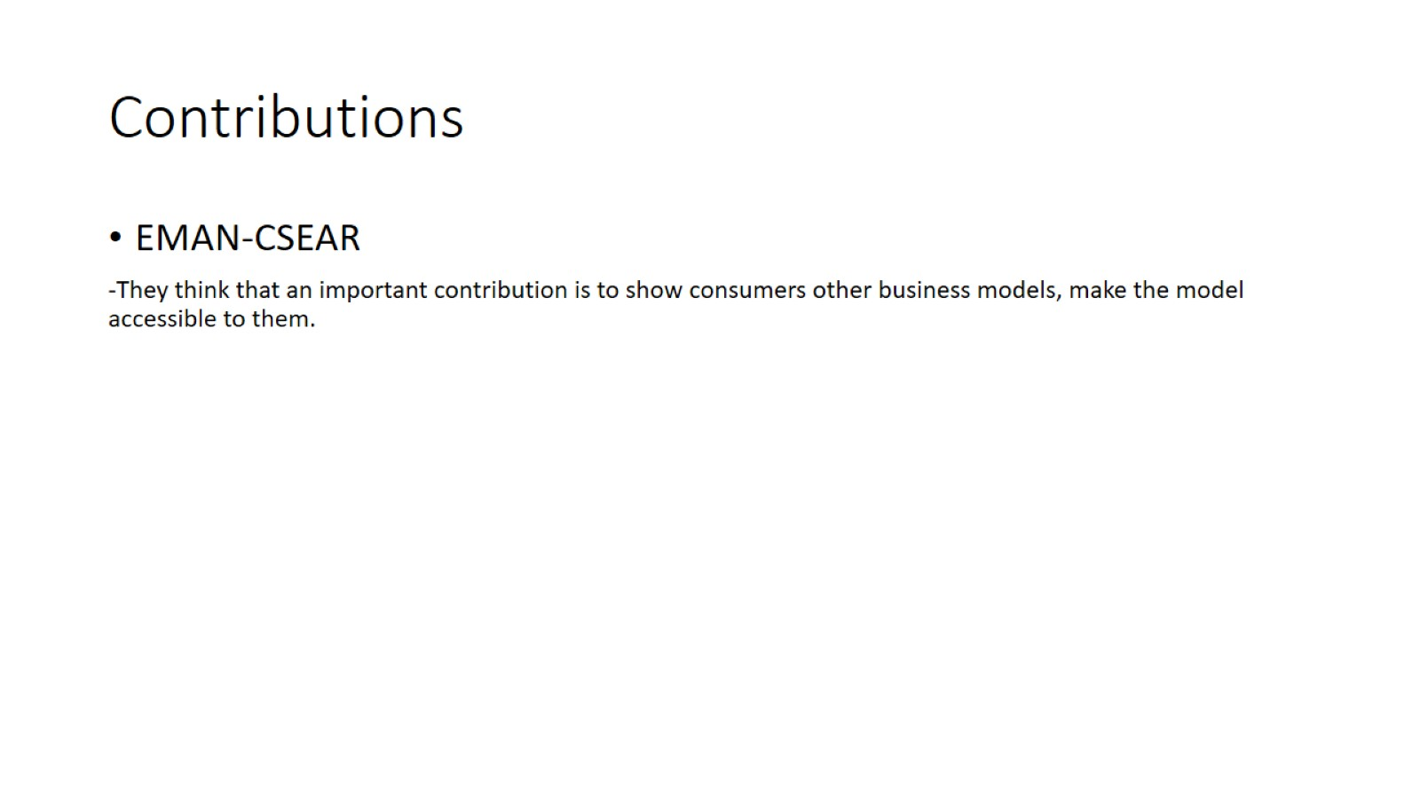
Contributions

